Slide 1
Emergency Management System for Fire Station

Slide 2
Presented By
Akshay G Pillai UR13IT004
Atul Thomas UR13IT017
Gokul Mohan Pillai UR13IT035
Sreenath S UR13IT105

Slide 3
Introduction:
The Emergency Management System App is an android application that helps to alert message various emergency services at the same time during various natural or man-made disasters.
The alert message that is send contains not only the location of the person who is stuck in the problem but also the type of disaster he is stuck and the description about the problem.
User can also add a third party number (say a family member’s number) to whom an alert will be send along with the emergency services.

Slide 4
Objectives
The System is intended to function in case of emergencies in society.
The emergencies include Fire, Medical Emergencies, accident and External Emergencies such as Earthquake, Floods, Storm, etc.
Emergency Management System (EMS) enables smartphone based ad-hoc communications at disaster times over Wi-Fi.
Emergency management system also provides information and data about the safety procedures to be taken during respective disasters.

Slide 5
Technologies Used
Java:
Java is a general-purpose computer programming language that is concurrent, class-based, object-oriented, and specifically designed to have as few implementation dependencies as possible.
Android Studio:
Android Studio is the official integrated development environment (IDE) for Android platform development.
It is Google's primary IDE for native Android application development.

Slide 6
Continued…
Firebase:
Firebase is a mobile and web application platform with tools and infrastructure designed to help developers build high-quality apps. Firebase is made up of complementary features that developers can mix-and-match to fit their needs.
Genymotion:
Genymotion is an Android simulator that lets you create virtual replicas of Android systems and run them on your Windows computer.
This tool lets you emulate a large number of Android devices and control simulated sensors like battery, GPS, and accelerometer.

Slide 7
MODULES:
The Modules are mainly eight buttons:
Contacts
Emergency
Alert Page
Acess Location

Slide 8
contacts :
The contacts module consists of a text field where the user can include a number of any friends, relatives or any acquaintance to whom he/she can contact in an emergency situation. There is also various number of various emergency numbers provided in this page with the person can use to contact in such emergency situations
Emergency:
This module helps in preparing the user in advance from all the possible calamities such as fire, flood, earthquake, etc. There is a detailed description provided in this page on how to take appropriate actions during various calamities, in this way the app not only helps during emergency but also prepares the user for the same.
ALERT PAGE:
The alert page helps the user to send alert message to multiple emergencies and family members or others whose contact numbers are given in the terms page.

Slide 9
Database:
Firebase is a mobile and web application platform with tools and infrastructure designed to help developers build high-quality apps. Firebase is made up of complementary features that developers can mix-and-match to fit their needs. Firebase provides a realtime database and backend as a service. The service provides application developers an API that allows application data to be synchronized across clients and stored on Firebase's cloud.

Slide 11
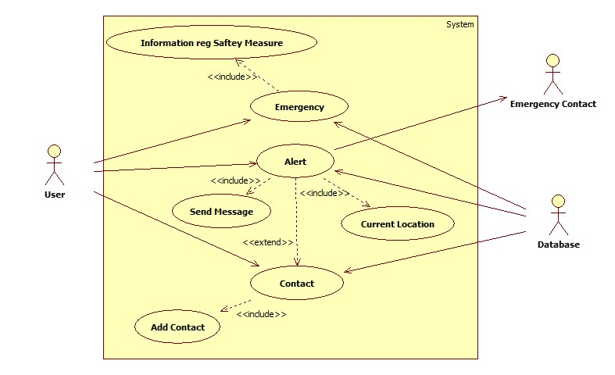
UML Diagrams
Use-case Diagram

Slide 12
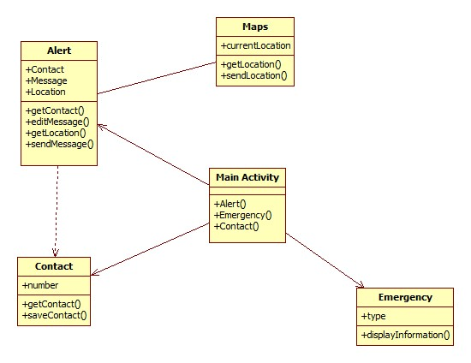
Class Diagram

Slide 13
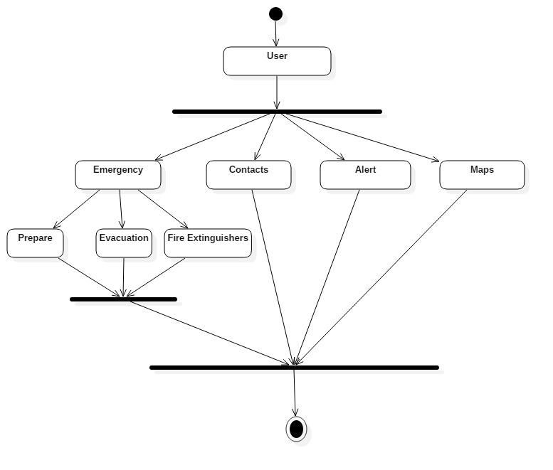
Activity Diagram

Slide 14
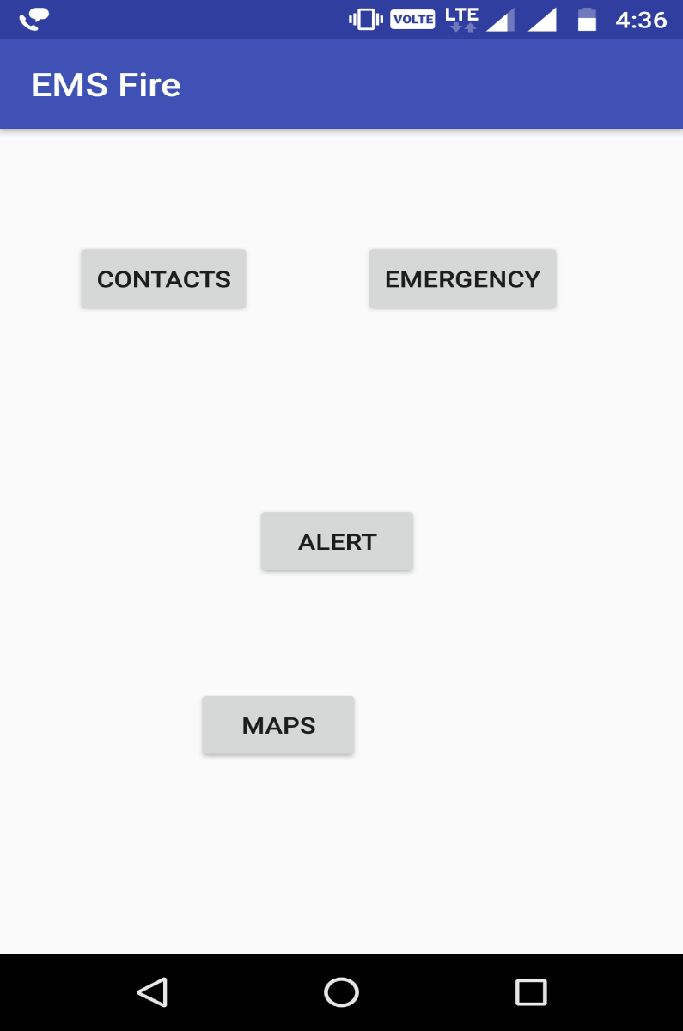
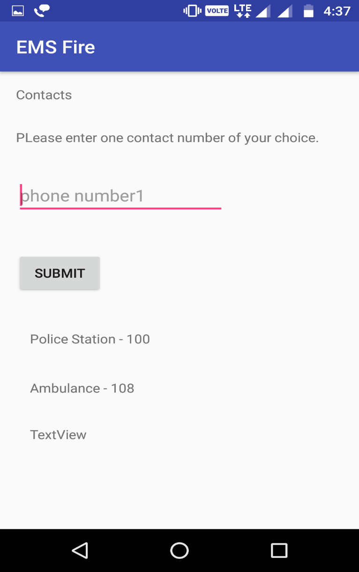
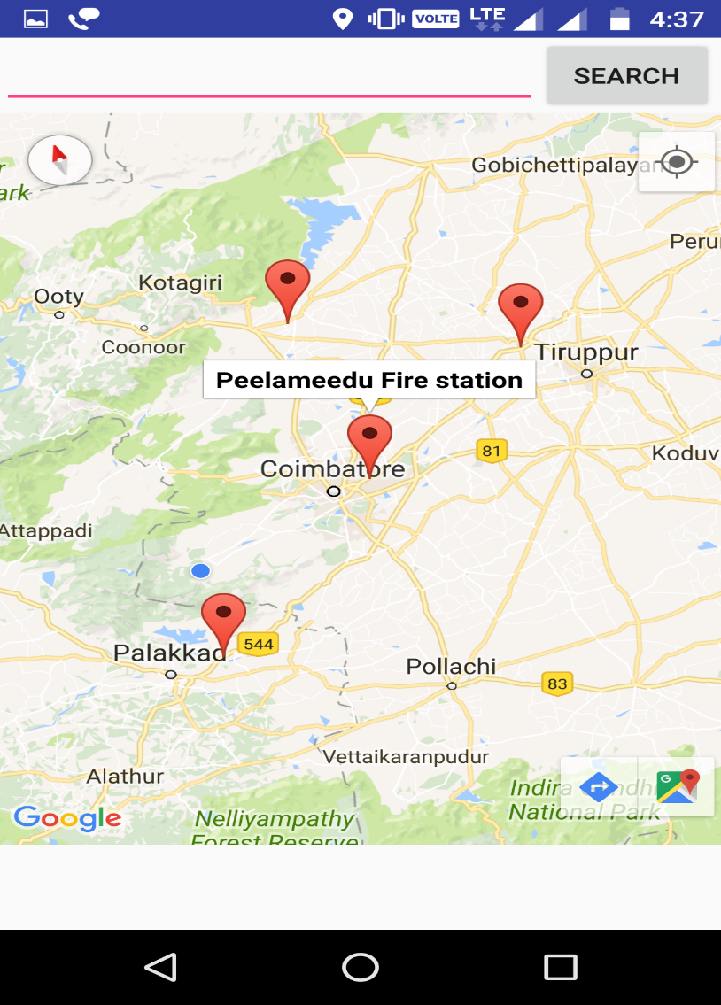
Screenshots
Design Page Contact page Navigation Page

Slide 15
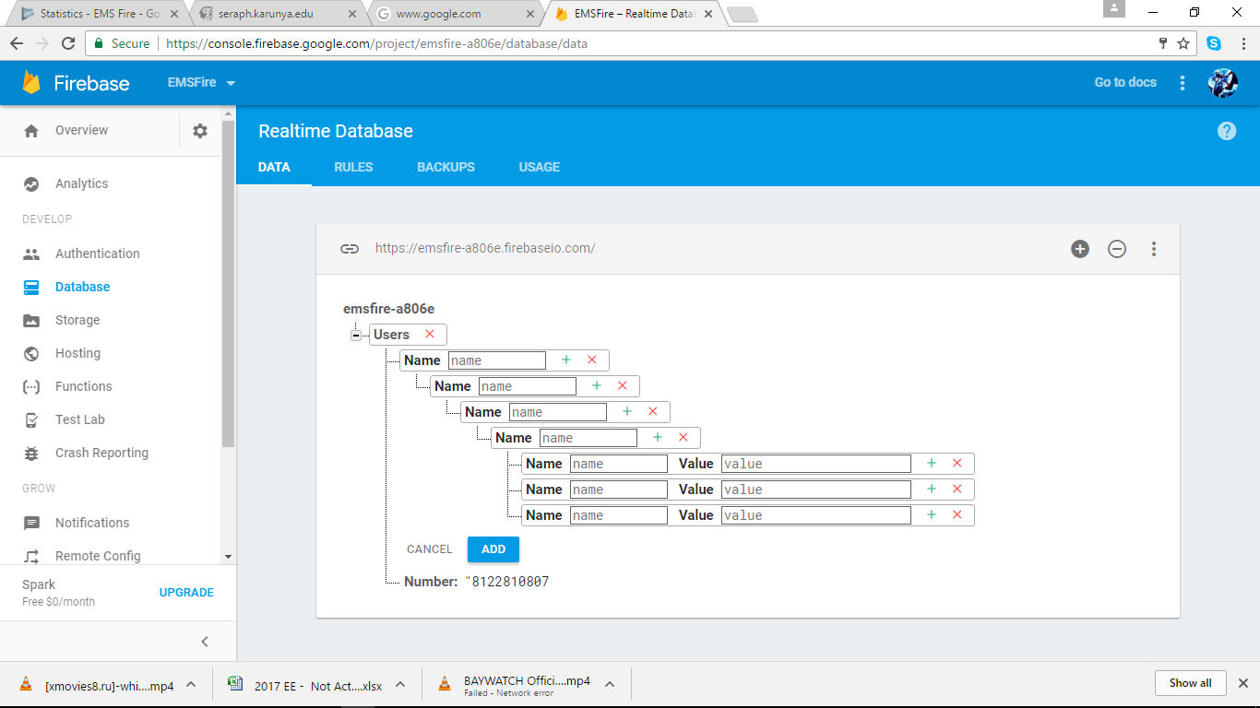
Data Entry

Slide 16
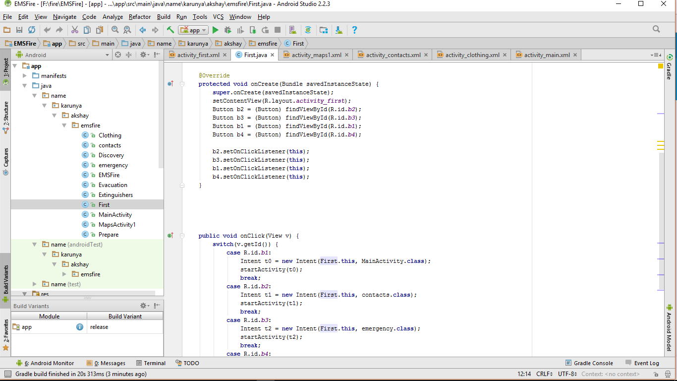
Design Implementation

Slide 17
CONCLUSION AND FUTURE SCOPE:
This application gives an architecture which will help the people in any emergency situation using their android smart phones by providing the help from a rescue team. It responds to public emergencies and EMS system fulfills the requirement of adhoc communication between skilled personnel for disaster times when no other means of communication exist

Slide 18
The future scope for the application:
As the technology emerges, it is possible to upgrade the system and can be adaptable to desired environment.
Because it is based on object-oriented design, any further changes can be easily adaptable.
Based on the future security issues, security can be improved using emerging technologies.
It is also possible to start an interface for the fire department officials to enter useful data such as nearest fire station.
The app can also be used to spread awareness among different users about safety procedures in different emergency situations.

Slide 19
REFERENCES:
[1] Android Programming: The Big Nerd Ranch Guide (Big Nerd Ranch Guides)
[2] Professional Android 4 Application Development by Reto Meier
[3] [online] Introduction to Android:
http://developer.android.com/guide/index.html
[4] [online] AndroidUserInterfaces:
http://developer.android.com/guide/topics/ui/index.html

